Slide 1
WBSFLIX
Recommender System
Presented by : Group - 3

Slide 2
Recommender System for WBSFLIX
WBSFLIX is a DVD store near Berlin.
The task is to build a recommender system for WBSFLIX
WBSFLIX shared store database
WBSFLIX

Slide 3
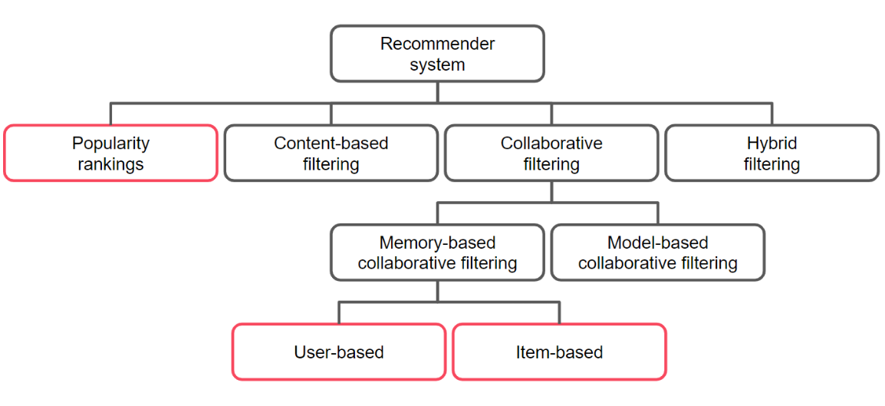
Filtering to suggest relevant items
WBSFLIX

Slide 4
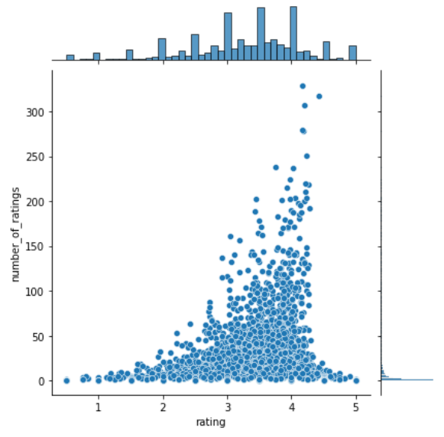
Most watched movies based
Simple and non-personalized approach
Considered balance of rating ( top_10 movies rating count 200-330)
WBSFLIX

Slide 5
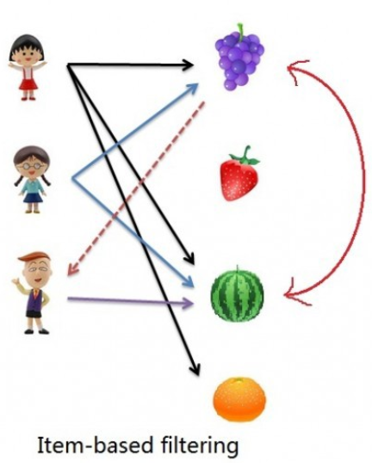
Item based filtering
Focused on items ( movies )
Rating count >= 100/movie
Calculated similarity among the movies
using Pearson’s correlation
Recommendations
WBSFLIX

Slide 6
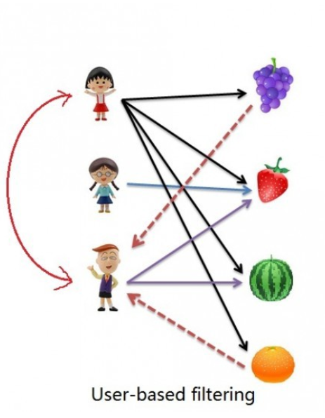
User based filtering
Focused on users
Replace missing values
Calculated similarity using cosine similarity
Turn similarities into weights
Estimate the missing rating
Recommendations
WBSFLIX

Slide 7
Streamlit App and Chatbot
https://recommender-system-flix.herokuapp.com/
WBSFLIX

Slide 8
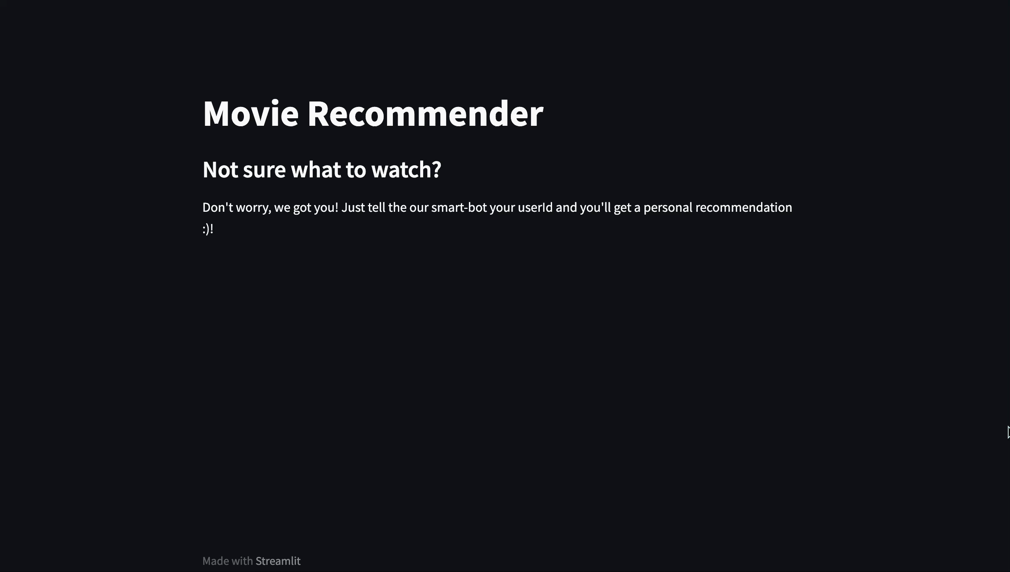
Chatbot Video
WBSFLIX

